Slide 1
EXP 11A –
Synthesis of Alum
Lab Introduction
Have you done your pre-lab quiz on Canvas?
Have out:
  Goggles, pencil, calculator, lab packet
Backpacks in front of classroom
  No food or beverages - put it away

Slide 2
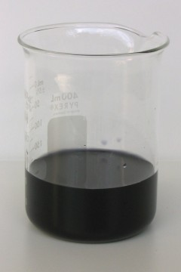
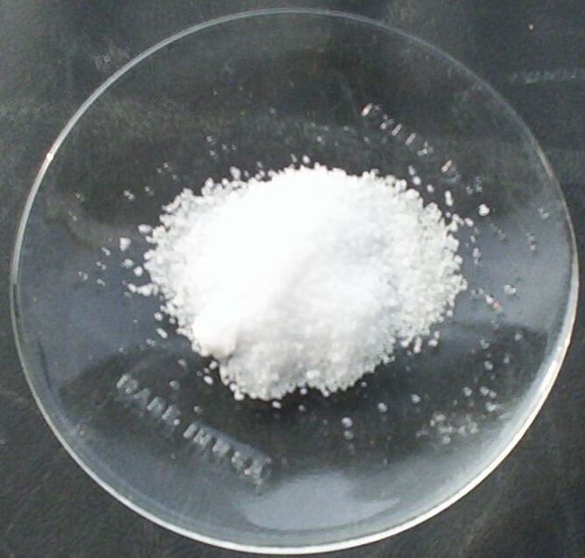
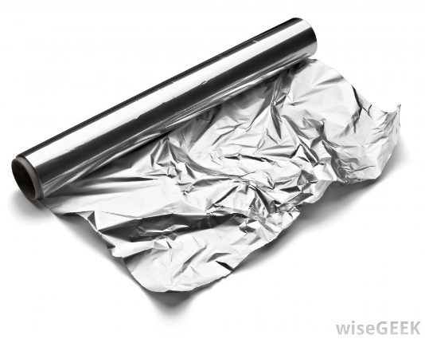
Introduction
Today we will be making potassium aluminum sulfate dodecahydrate (KAl(SO₄)₂•12H₂O) – aka Alum
  We will be making Alum from using aluminum powder
    Aluminum metal was named after the compound Alum.
Al(s)
KAl(SO₄)₂•12H₂O(s)
KAl(OH)₄(aq)
Your Alum may be brownish white.

Slide 3
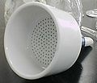
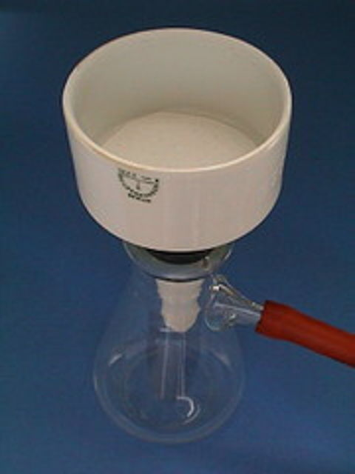
Setup:
While waiting for the Al powder to completely react, you can calculate your theoretical yield of Alum
  We are assuming Al powder is the limiting reactant
  You may move on when no more Al powder is visible. Swirl every few minutes.
You won’t know your actual yield until you weigh your product at the very end.
  Vacuum Filtration apparatus
    Rinsing beaker

Slide 4
Safety
Step 5 & 6:
  Be very careful with the sulfuric acid! It is very corrosive.
  Add acid slowly to reaction beaker.
    One person stirs the reaction while the other person adds the sulfuric acid. Very neat to watch.
    Very exothermic. Keep working in the fume hood.
  Be careful not to touch the gloves to your skin. This is how accidental chemical burns happen.

Slide 5
Recording Data:
The Data Report is short.
  Make sure you have units on all measured values
  Show your work
    For full credit, setup theoretical yield has one calculation (one equal sign)

Slide 6
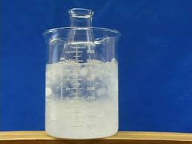
Do’s and Don’ts
Do work in the fume hood when instructed to do so.
DO make your own personal ice bath
DON’T boil your reaction
  Use the pancake griddles in the fume hood when you need to heat your reaction
DON’T leave alum crystals on wet filter paper to dry (it will take forever)
  Gently scrape off onto a watch glass (put a paper towel underneath for easier cleanup).
  Spread it out so it will dry faster.
  Also, the paper is not part of your actual yield measurement

Slide 7
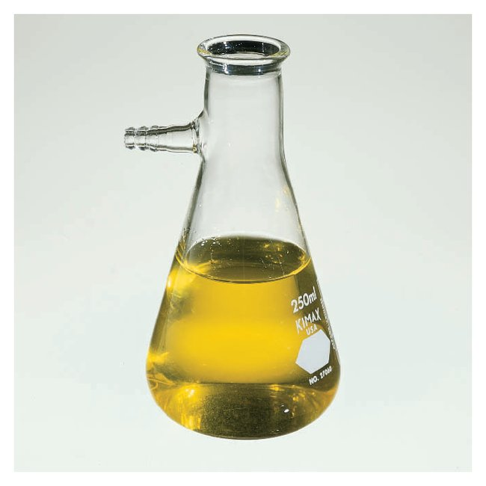
Clean Up and Waste Disposal
Side Arm Flask
Alum
Aqueous Waste (Large Plastic Jug)
Solid waste (Small plastic bottle)
Filter Paper
Trash can (remove as much Alum as you can first)

Slide 8
Data-Report
Data Reports are Individual Assignments
  You may ask your classmates for help, and you can cross-check before you turn it in
  Do not copy or let others copy
  Be neat and clear
Use complete sentences
  One-word answers are insufficient.
  Use vocabulary terms correctly
Double-check your charges and phase symbols before you turn it in!
Turn-in Data-Report pages ONLY
  Save the procedure for Lab-Practical (end of the semester)

